Slide 1
EIRSAT-1 ADCS
Daire Sherwin, Joseph Thompson, Victorio Ubeda
01/09/2017
The EIRSAT-1 project is carried out with the support of the Education Office of the European Space Agency, under the educational Fly your Satellite! Programme

Slide 2
Software
MATLAB / Simulink
Highly standardized in control engineering
MATLAB integrates well with other simulation software
Can generate C / C++ code
Level-2 S functions
Allow the integration of custom Matlab code into Simulink

Slide 3
ADCS Model
Disturbances
Aerodynamic drag
Gravity gradient
Solar radiation
Internal magnetic Dipole
+
Dynamics
Orbital Dynamics
Rotational dynamics
Environment
Magnetic Field
(IGRF. Spherical harmonics)
+
Control
PID
LQR
WBC
Mode selection
Detumbling
Zenith pointing
Sun pointing
Sensors
Delay
[…]
Actuator
Reference

Slide 4
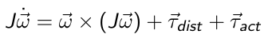
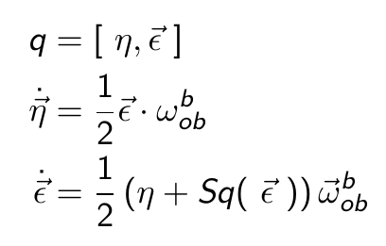
Rotational Dynamics
Rotational Dynamics and Kinematics
Dynamics.
Euler Equations
Kinematics
Quaternions
Why quaternions?
Euler angles / Roll – Pitch – Yaw may produce singularities when calculating Rotation Matrix

Slide 5
Orbital Dynamics
Short time Scale
No need for precision in position
Assumed circular orbit
Constant orbit angular velocity
Specified Argument of Periapsis and True Anomaly

Slide 6
Reference
Two reference quaternions
Zenith / Nadir Pointing
Sun Pointing (Inertial reference frame)
%% Picture of reference frames %%

Slide 7
Wave – Based Control
Launch a Wave
Absorb the returning wave
Reject disturbances

Slide 8
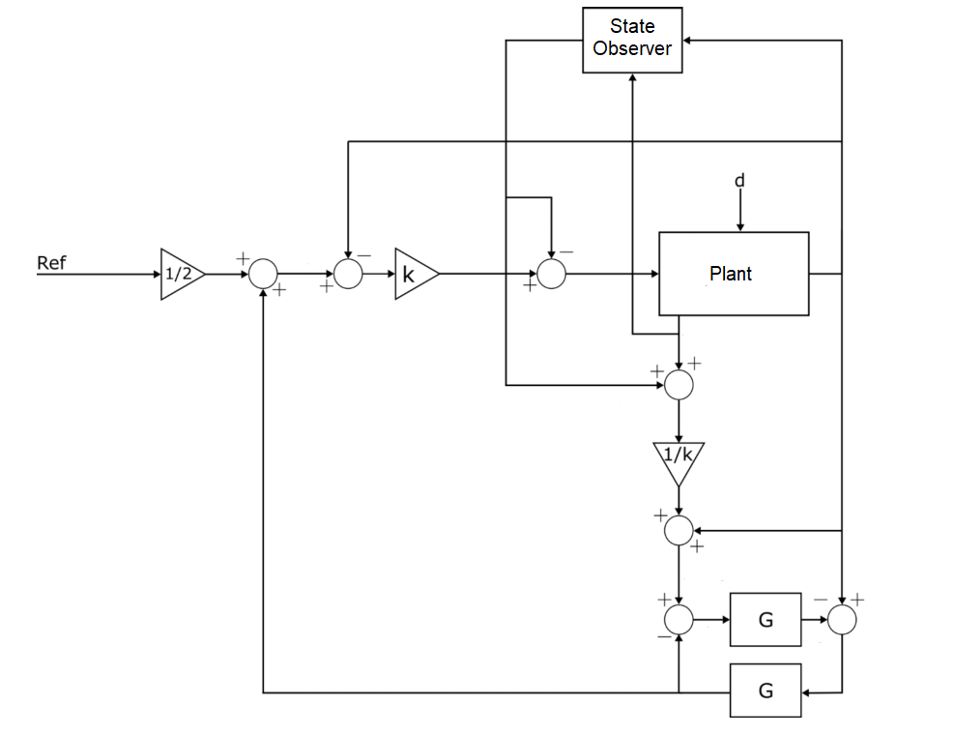
Wave – Based Control
Launch a Wave
Absorb the returning wave
Reject disturbances

Slide 9
Mode selection
Detumbling
[…]
Zenith / Nadir Pointing
[…]
Sun pointing
[…]

Slide 10
Sensors
Clyde Space Board
Magnetometer
IMU
GPS
Coarse Sun Sensor

Slide 11
Sensors
Delay
[…]
Noise
[…]
State Estimation (?). Extended / Unscendent Kalman Filters

Slide 12
Disturbances
Aerodynamic drag
Gravity gradient
Solar radiation
Internal magnetic Dipole

Slide 13
Solver
Runge Kutta 4 / 6
Variable step
Handled automatically by Simulink

Slide 14
Limitations and Improvements
Standardized Frame transformations
Full documentation
Third – Body Forces

Slide 15
Hardware. Clyde Space Board
%% Technical specifications from manual %%

Slide 16
Hardware. Clyde Space Board
%% Technical specifications from manual %%

